Slide 1



OKCupid Date App Analysis
Mar Rubio

Slide 2


Introduction:
This project will analyze some data from OKCupid, an app that focuses on using multiple choice and short answers to match users. In recent years, there has been a massive rise in the usage of dating apps to find love. Many of these apps use sophisticated data science techniques to recommend possible matches to users and to optimize the user experience. These apps give us access to a wealth of information that we’ve never had before about how different people experience romance. The information was provided by Codecademy: profiles.csv

Slide 3
Project Overview
PROJECT GOALS
ANALYSIS
For many people, the fact that someone takes drugs is crucial when deciding to start a relationship or not with that person. Since many users did not answer to this question, this project aims to determine if it is possible to predict the fact that someone takes drugs based on other variables.
This solution will use descriptive statistics and data visualization to find key figures in understanding the distribution, count, and relationship between variables. Since the goal of the project is to make predictions on the user's tendency to have drugs, classification algorithms from the supervised learning family of machine learning models will be implemented.

Slide 4
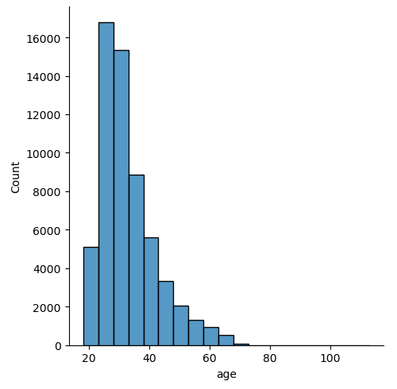
Exloratory Data Analysis (EDA)
Before building models, it is essential to analyze key features in the dataset to understand which variables are most relevant to the project's objective.
The histogram on the right displays the age distribution of users, with most users falling between 25 and 30 years old.

Slide 5
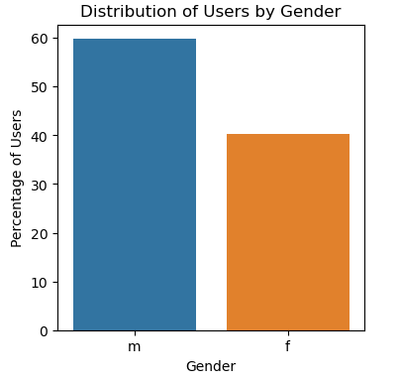
Exloratory Data Analysis (EDA)
Gender Distribution:
There is a significant difference in the number of men and women out of the total users. 60% of users are men and 40% women. This data is relevant for the analysis of the rest of the features.

Slide 6
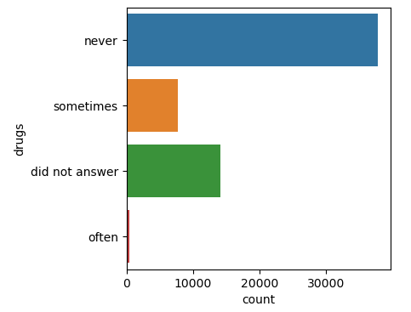
Exloratory Data Analysis (EDA)
Drugs:
It’s important to examine this feature, as it is the focus of this project. The plot illustrates that the majority of users never consume drugs. However, there is a significant number of users who didn’t answer. This is what this project aims to predict.

Slide 7
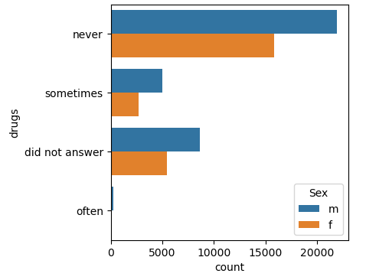
Exloratory Data Analysis (EDA)
The comparison now focuses on gender differences. The data suggests that men report higher drug use than women. However, it is important to acknowledge the possibility that men may have been more forthcoming in their responses compared to women. Since honesty in self-reporting cannot be measured, the conclusion drawn from the available data is that drug use is more prevalent among men than women.

Slide 8
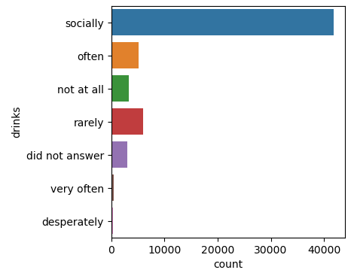
Exloratory Data Analysis (EDA)
Drinks:
The chart illustrates the frequency of alcohol consumption among users. The number of users who drink alcohol "often" or "very often" is comparable to those who take drugs at the same frequency (410 for drugs and 471 for alcohol). However, the key takeaway is that most users consume alcohol socially.

Slide 9
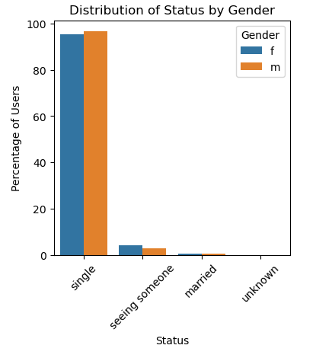
Exloratory Data Analysis (EDA)
Status:
The status of users is a very important feature, since this is an app for finding love, or at least have a date with someone you might like. If a user is married, in most cases it could mean that that person is not looking for something serious. The following plot shows the percentage of users within each category. Most users are single, which make sense.

Slide 10
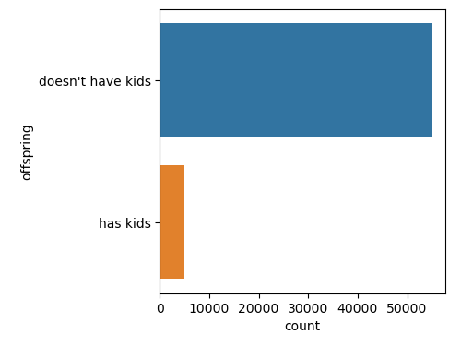
Exloratory Data Analysis (EDA)
Offspring:
Parenthood may be a significant factor influencing drug consumption. Many individuals quit drug use completely when they have children, suggesting that the likelihood of drug use is higher among those without offspring compared to those who are parents.

Slide 11
Preprocess Data
Since the dataset was too large, removing high-weight columns was necessary to enhance model performance.
The “Drugs” category originally had four values: “never”, “did not answer”, “sometimes” and “often.” To balance the class distribution, we merged two categories, resulting in a binary classification: “never” and “did not answer” were assigned a value of 0, while “sometimes” and “often” were grouped as 1.
Before splitting the data, categorical variables were converted into numerical values. Variables with an inherent order were transformed using Label Encoding, while those without a meaningful order were processed with One-Hot Encoding (OHE).

Slide 12
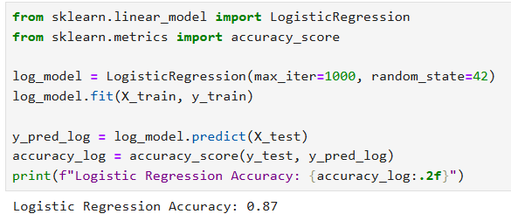
Build Models
Logistic Regression:
Since this is a binary classification problem with two possible outcomes (0 or 1), Logistic Regression is a suitable model to start with. It predicts the probability that an instance belongs to a particular class and assigns it accordingly. The code snippet on the right shows the implementation, where the model achieves an accuracy of 0.87 on the test data.

Slide 13
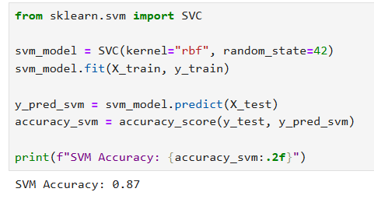
Build Models
Support Vector Machine:
The Support Vector Machine (SVM) is another model well-suited for classification tasks like this one. The code snippet on the left demonstrates its implementation, using the RBF kernel. The model performs similarly to Logistic Regression, achieving an accuracy of 0.87 on the test data.

Slide 14
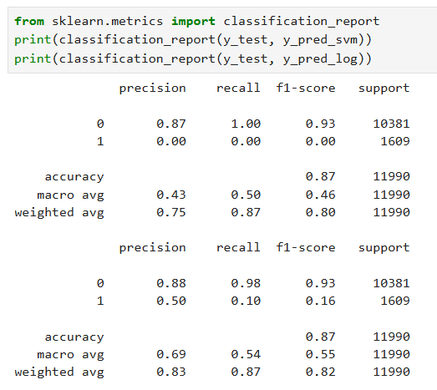
Evaluate Models
Evaluation metrics:
The results indicate that the SVM model struggles to accurately predict users who take drugs ('Sometimes'/'Often'). As shown in the code snippet on the right, the precision, recall, and F1-score for this category are all 0, meaning the model fails to identify any drug users correctly. This suggests that adjustments, such as balancing the dataset or tuning hyperparameters, may be necessary to improve performance.

Slide 15
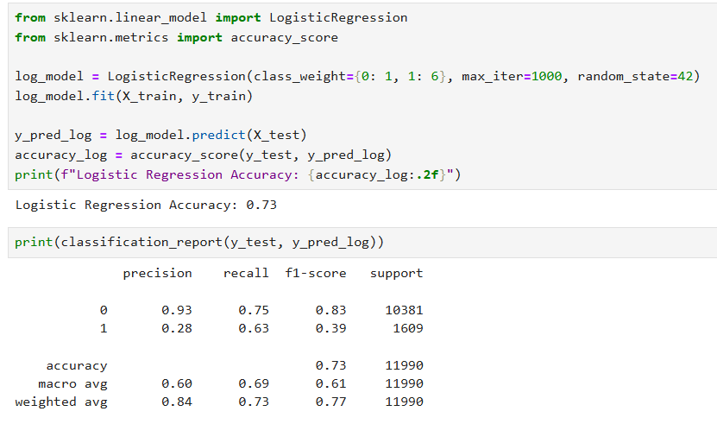
Hyperparameter Tuning for Logistic Regression
The first version was a simple introduction, stating that Logistic Regression was chosen because the problem involves two categories (0 or 1). It lacked depth and did not explain model performance.
The improved version adds hyperparameter tuning, addressing class imbalance (1:6 ratio) because there are 51,804 instances of class 0 (non-drug users) and only 8,142 instances of class 1 (drug users). This adjustment helps the model focus more on detecting drug users. It also explains how it impacted precision, recall, and F1-score, highlighting the trade-off: lower accuracy but better recall for drug users, making the model more balanced.

Slide 16
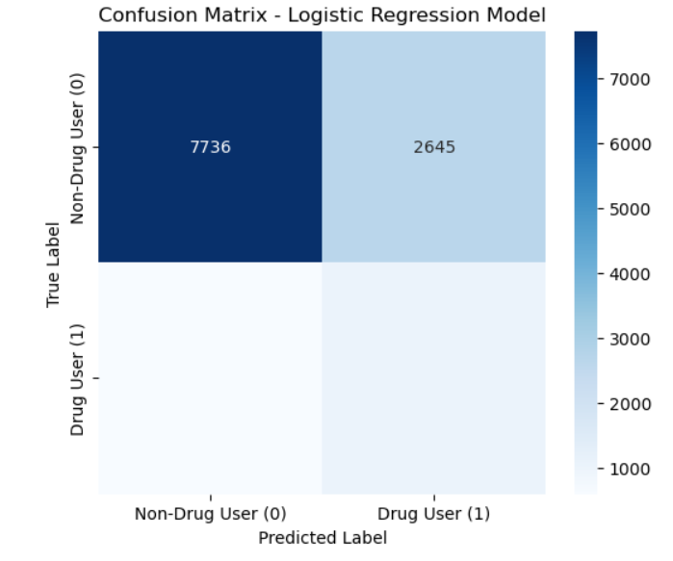
Performance Evaluation
This confusion matrix shows how well the Logistic Regression model predicts drug use. The top left square (7736) represents correctly identified Non-Drug Users, while the top right (2645) shows Non-Drug Users mistakenly classified as Drug Users. The bottom left and bottom right squares indicate that the model struggles to correctly identify Drug Users, meaning it tends to classify most people as Non-Drug Users. This suggests an imbalance in the predictions, which will require further model adjustments.

Slide 17
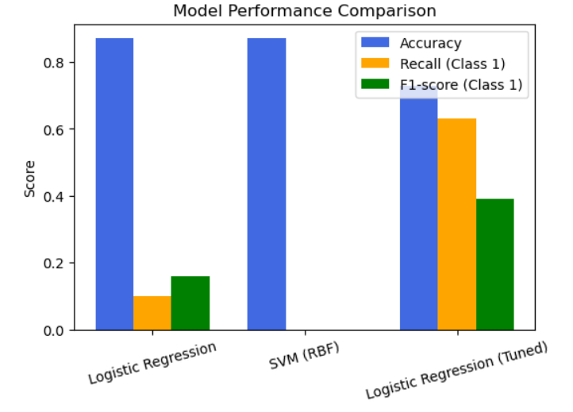
Conclusions and Next Steps
Conclusions:
For this prediction task, determining whether a user takes drugs or not, the Support Vector Machine (SVM) did not prove to be useful due to poor recall for drug users. Logistic Regression performed better, but the model still did not yield the expected results. However, with further hyperparameter tuning, resampling techniques (oversampling/undersampling), and feature selection, we could improve predictions. Class imbalance remains a major challenge, as the model struggled to identify the minority class correctly.
Next Steps:
To further enhance model performance, we should prioritize addressing class imbalance early on through proper data resampling techniques. Exploring alternative models such as K-Nearest Neighbors (KNN) or Random Forest could improve prediction accuracy. Additionally, fine-tuning hyperparameters, performing feature selection, and testing different evaluation metrics (e.g., AUC-ROC) could provide deeper insights into model performance.

Slide 18
Thank you for your time!

